Slide 1
Intern Presentation
21 Jul 2023
Chan Ming Han
Attached to: RA, RB / AAR
Supervisors: Lionel, Benson
Notes:
Good afternoon, I am Ming Han, and today I shall be presenting the project that I embarked on in the last 2-3 months.

Slide 2
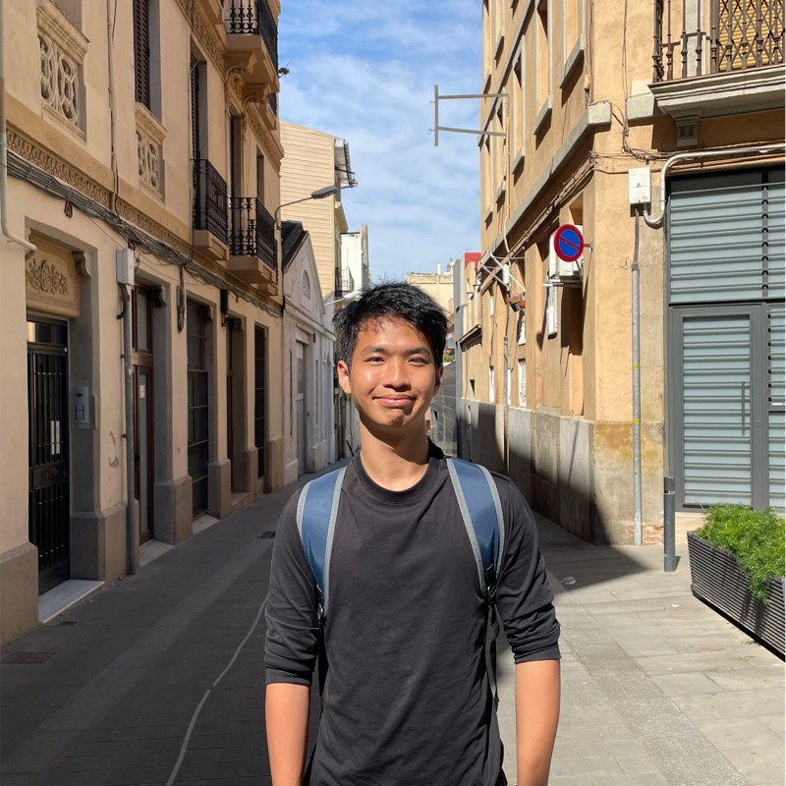
About me
Year 2 student (Renaissance Engineering Programme, NTU)
Specialising in Computer Engineering, keen interests in the FinTech space and drones!
Going to UC Berkeley for exchange this August, hoping to explore the world, and further my knowledge Computer Science related modules.
Notes:
First off, a little bit about myself. I am currently a year 2 student reading the Renaissance Engineering programme at NTU, with a specialization in computer engineering. In year 3, I am going to UC Berkely for exchange and hope to be able to do modules related to quantitative finance and optimization models. Let me now give you a little bit of background on the project.

Slide 3
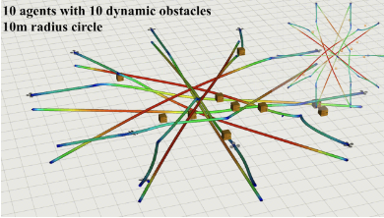
Background of Project
MIT Publication: Robust – MADER
Decentralized and Asynchronous Multiagent Trajectory Planner Robust
to Communication Delay
Algorithm based on MADER which was robust to communication delays, and guaranteed to be 100% collision free
Fig[1]: 10 Agents with 10 dynamic obstacles with RMADER Algorithm
Notes:
Recently, MIT published a paper on their RMADER drone trajectory planner. This stands for ROBUST MADER, and according to the simulations documented on the paper, RMADER was said to be robust to communication delays and guaranteed to be 100% collision free. From here, my task was to evaluate the performance of RMADER, to see whether it was implementable on our current drone systems.

Slide 4
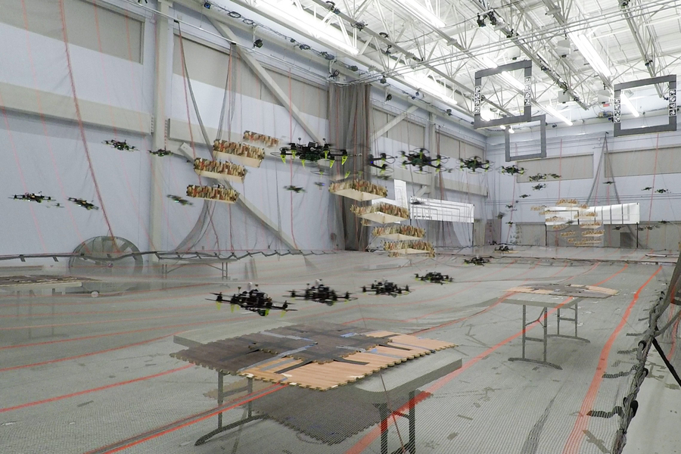
Background of Project
MIT Publication: Robust – MADER
Decentralized and Asynchronous Multiagent Trajectory Planner Robust to Communication Delay
Algorithm based on MADER which was robust to communication delays, and guaranteed to be 100% collision free
Fig[1]: 10 Agents with 10 dynamic obstacles with RMADER Algorithm
MADER: A trajectory planning system that enables drones working together in the same airspace to always choose a safe path forward
Fig[2]: MADER Simulation of Drone in real environment
Notes:
In essence, MADER is a trajectory planning system that enables drones working together in the same airspace to always choose a safe path forward.

Slide 5
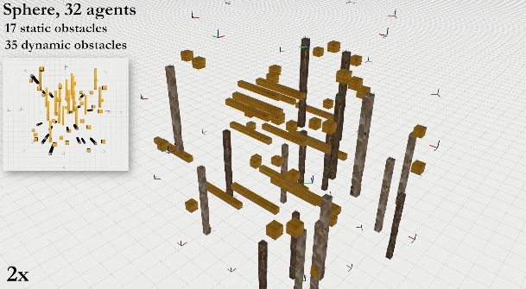
Value of MADER
Asynchronous and Decentralized
Fig[3]: Spherical configuration of 32 Agents with dynamic obstacles
Plan
Optimization
Check
Notes:
Before we delve into the performance of RMADER, lets first look at the core functionality of MADER, and why it is worth us studying.
MADER is both Asynchronous and Decentralized, meaning that each drone formulates its own trajectory and that, while all agents must agree on each new trajectory, they don’t need to agree at the same time. This makes MADER more scalable than other approaches, since it would be very difficult for thousands of drones to agree on a trajectory simultaneously.
Secondly, due to its decentralized nature, the system would also work better in real-world environments where drones may fly far from a central computer. This also means that there is no single point of failure, making the system more reliable.

Slide 6
Value of MADER
Asynchronous and Decentralized
Plan
Optimization
Check
Find a possible trajectory. Trajectories of the agent are not committed currently.
Search Algorithm Used: Octopus Search
Includes all polyhedral representations of the trajectories in the constraints. All trajectories other agents commit to are stored.
To check whether the trajectory found in the optimization step collides with trajectories that other agents have committed to during the optimization.
Notes:
MADER’s algorithm can be broken down into 3 main parts, planning, optimization, and checking.
In the planning phase, the algorithm generates a possible trajectory using octopus search.
Next, this trajectory is then optimized subject to polyhedral representations of all other agent trajectories.
Lastly, the trajectory generated in the optimization step is then checked with other trajectories that other agents have committed to during the optimization.

Slide 7
Value of MADER
Asynchronous and Decentralized
Plan
Optimization
Check
Find a possible trajectory. Trajectories of the agent are not committed currently.
Search Algorithm Used: Octopus Search
Includes all polyhedral representations of the trajectories in the constraints. All trajectories other agents commit to are stored.
To check whether the trajectory found in the optimization step collides with trajectories that other agents have committed to during the optimization.
Key Assumption: Perfect Communication
Notes:
Based on the flow of the algorithm alone, it would seem like it is impossible for trajectories to clash. And that is true, under the key assumption that there are no communication delays.
Communication delays can be catastrophic for multiagent systems. Further, existing state-of-the-art multiagent trajectory planners assume perfect communication and therefore lack a strategy to rectify this issue in real-world environments.

Slide 8
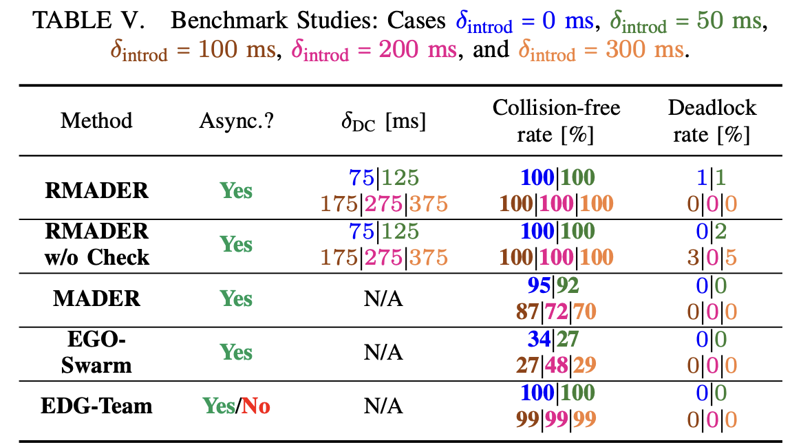
Value of RMADER
Plan
Optimization
Check
Delay Check
Find a possible trajectory. Trajectories of the agent are not committed currently.
Search Algorithm Used: Octopus Search
Includes all polyhedral representations of the trajectories in the constraints. All trajectories other agents commit to are stored.
To check whether the trajectory found in the optimization step collides with trajectories that other agents have committed to during the optimization.
Agent keeps receiving trajectories from other agents and storing them, repeatedly checking if its newly optimized trajectory is conflicting.
Figure[4]: Benchmark Studies
Kondo, K. (2023, March 10). Robust MADER: decentralized multiagent trajectory planner robust to communication delay in dynamic environments. arXiv.org. https://arxiv.org/abs/2303.06222
Notes:
The RMADER algorithm rectifies this issue by implementing a Delay Check, where the agent keeps receiving trajectories form other agents and storing them, repeatedly checking if its newly optimized trajectory is conflicting.
Based on the paper, RMADER was shown to be 100% collision free with a introduced communication delay of up to 300ms.

Slide 9
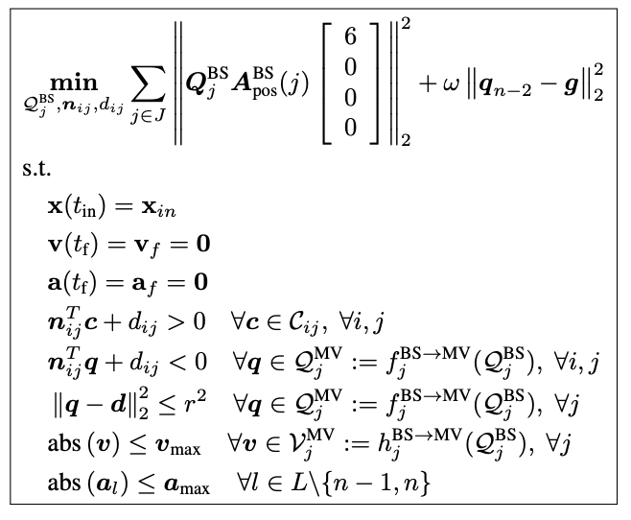
The Optimization Problem
Initial & Final States
x: Position
v: Velocity
a: Acceleration
Collision-free constraints
Penalty Cost for distance from end goal
Actuator and Physical constraints
Fig[5]: Optimization Problem
Tordesillas, J. (2020, October 21). MADER: trajectory planner in multi-agent and dynamic environments. arXiv.org. https://arxiv.org/abs/2010.11061
Notes:
Firstly, before I could begin looking in to RMADER, I had to understand a rough overview of the optimization problem that the RMADER algorithm used to optimize their trajectories.
For starters, this was the optimization problem as written out in the MADER paper.
Firstly, we have the initial and final states of the drone, which are set to allow the optimization to remain convex, saving on computational expense.
Next, these represent the collision-free constraints, to ensure that the optimized trajectory does not collide with the cached set of trajectories.
Following this are the actuator and physical constraints.
Lastly, the distance from the goal is penalized as shown.

Slide 10
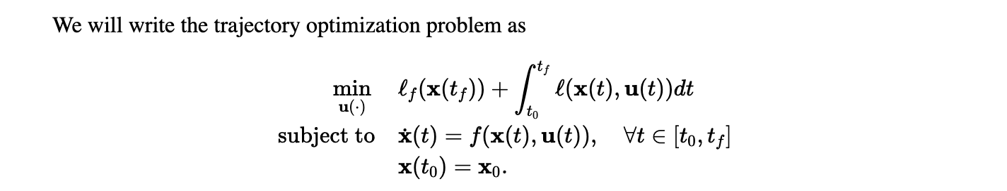

General Approach
Constrained Optimization Problem
Fig[6]: General Form of Optimization Problem
Tedrake, R. Ch. 10 - Trajectory Optimization. (n.d.). http://underactuated.mit.edu/trajopt.html
Hardware Requirements
INTEL NUC 10
64GB RAM
Notes:
In the test performed by the authors of the paper, the path generated was optimized using the GUROBI optimizer, with an INTEL NUC10 and 64GB RAM onboard the drone.
At first, we intended to use the GUROBI optimization library to test the performance of RMADER, but ultimately decided to pivot in another direction due to the great hassle of obtaining licensing for the GUROBI optimizer. As such, I opted to use the open source NLOPT solver to optimize the program instead.
Following this, Lionel and Benson also suggested another method of optimization -- unconstrained optimization, which was shown to be faster in certain cases.

Slide 11
General Approach
Constrained Optimization Problem
Unconstrained Optimization
GCOPTER: An optimization-based framework for multicopter trajectory planning, developed on novel optimality conditions for unconstrained control effort minimization.
Fig[6]: General Form of Optimization Problem
Tedrake, R. Ch. 10 - Trajectory Optimization. (n.d.). http://underactuated.mit.edu/trajopt.html
Hardware Requirements
INTEL NUC 10
64GB RAM
Notes:
As such, I looked into the GCOPTER library, which was an optimization-based framework for trajectory planning developed on unconstrained control effort minimization.

Slide 12
GCOPTER Background
GCOPTER framework transforms a generally constrained multi-copter planning problem into an unconstrained optimization that can be solved reliably and efficiently.
Spherical Spatial Constraint Elimination
Enforcing motion safety by confining trajectories into a feasible region.
Polyhedral Spatial Constraint Elimination
Eliminating polytope constraints through transformations on different coordinate systems.
Usage of time integral penalty functional
Integration of constraint violations to transform continuous time constraints into finite constraints.
Notes:
Essentially, the GCOPTER framework helped to transform a generally constrained multi-copter planning problem into an unconstrained optimization that could be solved reliably and efficiently.
It removes constraints through 3 main methods:
Spherical Spatial Constraint Elimination, whereby motion safety is enforced by confining trajectories into a feasible region.
Polyhedral Spatial Constraint Elimination, where polytope constraints are eliminated through transformations on different coordinates, and lastly,
The usage of a time integral penalty functional, where the the continuous time constraints are transformed into finite constraints by integrating the constraint violations.

Slide 13
Problem Statement
To compare and benchmark the performance of RMADER against GCOPTER for the optimization of autonomous flight trajectories, emulated by simulations done in ROS on Ubuntu 20.06.
Notes:
As such, the problem statement was to compare and benchmark the performance of RMADER against GCOPTER for the optimization of autonomous flight trajectories, emulated by simulations done in ROS on Ubuntu 20.06.

Slide 14
Setup of Test Space
Was found that performance of the path planner depended heavily on the computational resources available, as well as the number of discretization intervals.
Test was conducted over a Euclidean distance of ~30m
(-10, 10, 0) → (10, -10, 0)
Maze was set to be the same over 50 simulations for both GCOPTER and RMADER
Optimization in RMADER used the NLOPT Solver
Default settings for RMADER: 100 discretization Intervals
Default Settings for GCOPTER: 16 Discretization Intervals
Notes:
Before running test simulations on both algorithm, appropriate mapping of physical parameters such as mass, and actuator constraints such as thrust was performed.
It was also suspected that the performance of the path planner depended heavily on the computation resources available, as well as the number of discretization intervals.
As such, 2 sets of tests were done, one with the number of discretization intervals as the independent variable, and one with available computation resources as the independent variable.
The test space was a grid of 1x1x5m cuboid shaped obstacles, and the drone was set to traverse from –10, 10, 0 to 10, -10, 0.
The maze was set to be the same over 50 simulations for both the algorithms.

Slide 15
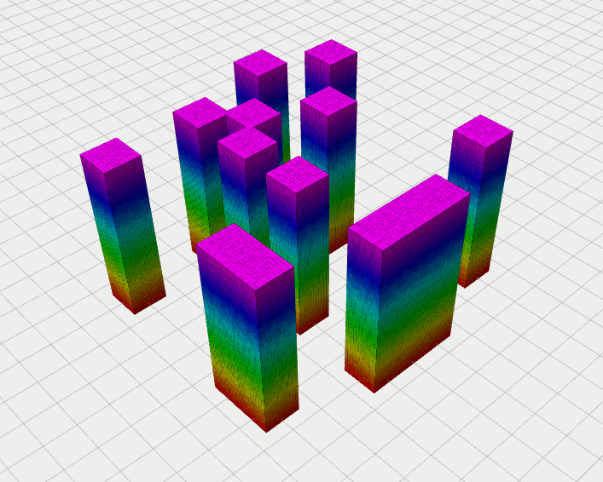
Setup of Emulation Environment
RMADER: CGAL Library
GCOPTER: mockamap Library
Identical maps created in both libraries using a random seed (123)
Emulation carried out in ROS, visualized using RViz
Test automation script written in bash to execute n=50 runs per simulation.
Fig[6]: Obstacle Setup (RViz)
Notes:
This slides shows the obstacle setup in Rviz.
The obstacles were input to the RMADER planner as CGAL representations of the obstacles, while they were input into GCOPTER via the mockamap libarary, or as a point cloud. I chose to stick to these representations of the obstacles due to the tight coupling between the planner and the obstacle representation.
50 runs were then done for each setting, and the results were visualized in Rviz.

Slide 16
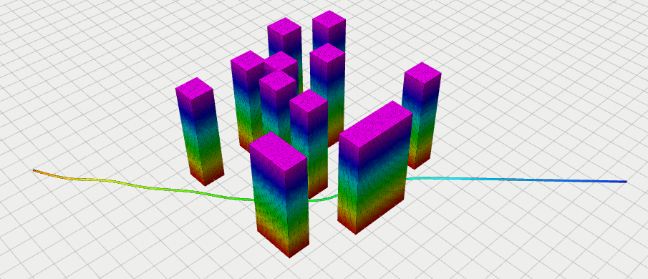
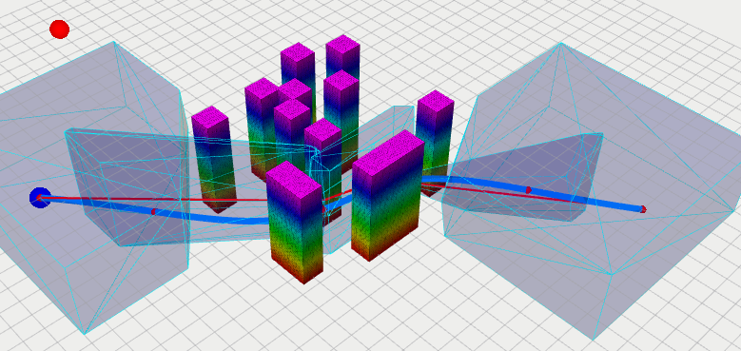
Path Planner (RViz)
RMADER
GCOPTER
(10, -10, 0)
(10, -10, 0)
(-10, 10, 0)
(-10, 10, 0)
Fig[7]: Path Generated by RMADER (RViz)
Fig[7]: Path Generated by GCOPTER (RViz)
Notes:
This graph shows the paths generated by RMADER and GCOPTER on the given maze.

Slide 17
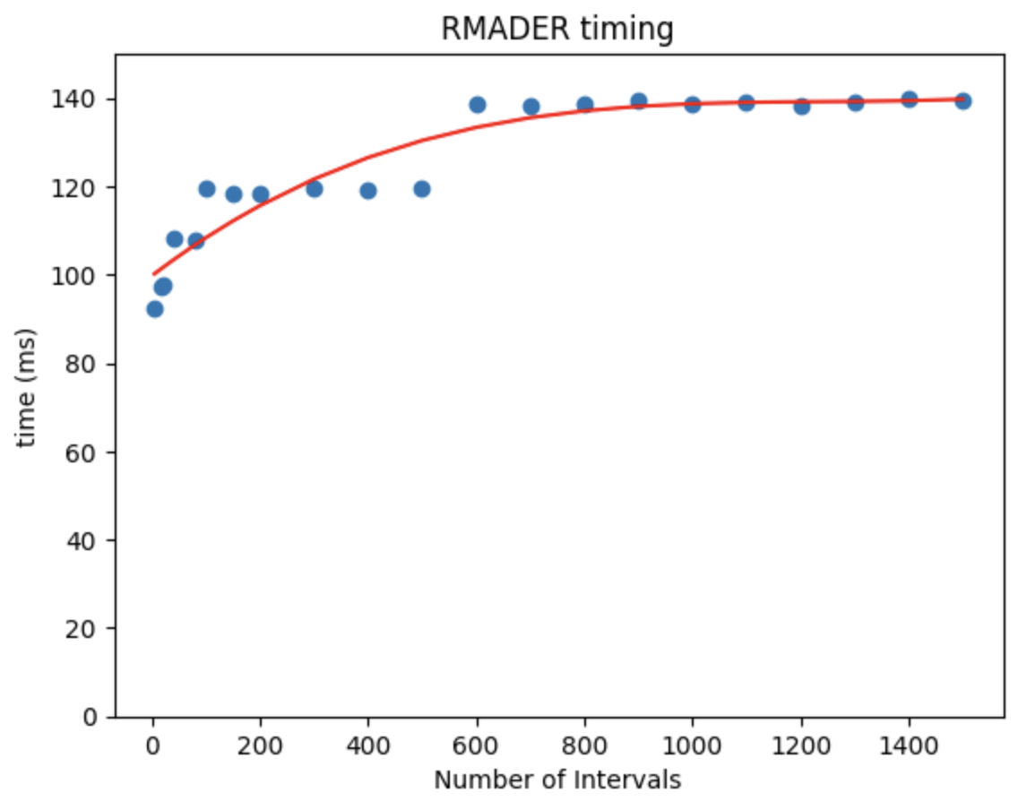
RMADER Performance
Observations
Positive, non-linear relationship between time and numIntervals
Noticeable ”step-ups” at n=40, n=100 and n=600 (Elaborated in Appendix C2)
“Step-ups” attributed to manual method of finding the max Runtime for the RMADER algorithm
Notes:
Explain the derivation of runtime for RMADER in this slide
Now, let us look at the performance of RMADER and GCOPTER and how they are affected by the number of discretization intervals.
In this graph, noticeable “step-ups” are noticed at n=40, n=100 and n=600. This is due to the implementation of RMADER, where it was set to break once it reached a maximum runtime. As such, I had to “guess” the minimum time needed to generate a complete path. Hence, due to the manual tuning of maximum run time, we see the “steps” in this graph.
That said, as the number of discretization intervals increased, we notice a positive, albeit non-linear relationship between time and the number of discretization intervals.

Slide 18
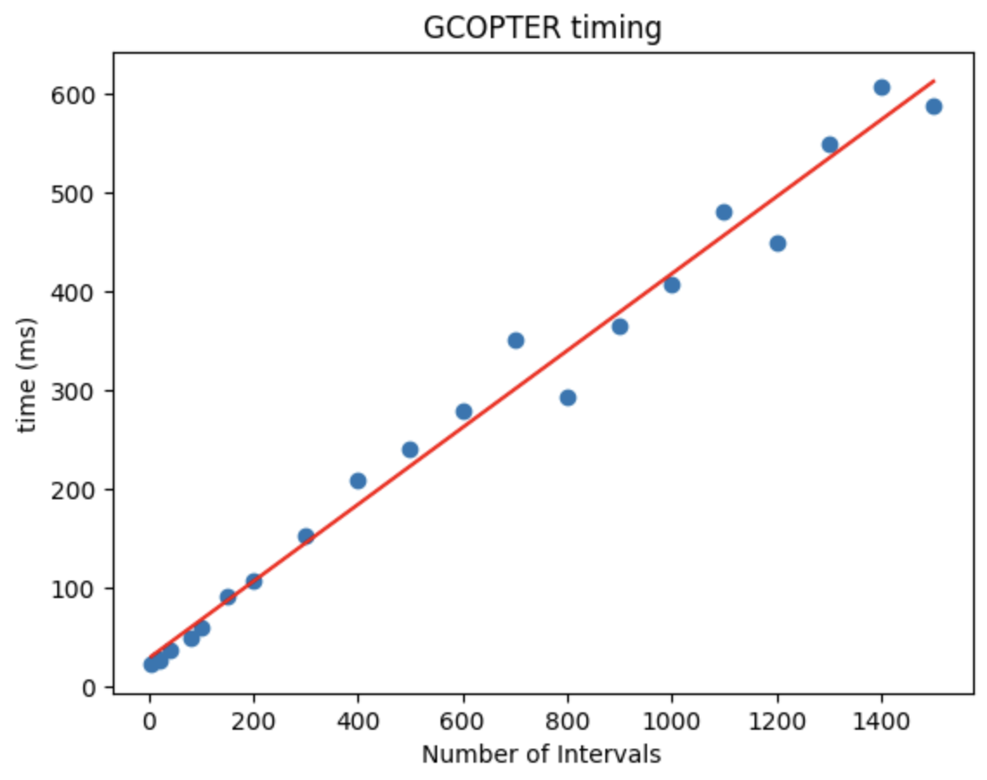
GCOPTER Performance
Observations
Strong, Positive, Linear relationship between time and numIntervals
Pearson Correlation Coefficient = 0.993
Notes:
Unsurprisingly, we see the same positive relationship with GCOPTER against the number of discretization intervals. In this case, the relationship is a linear one with an r-squared value of 0.993, indicating a strong positive correlation.

Slide 19
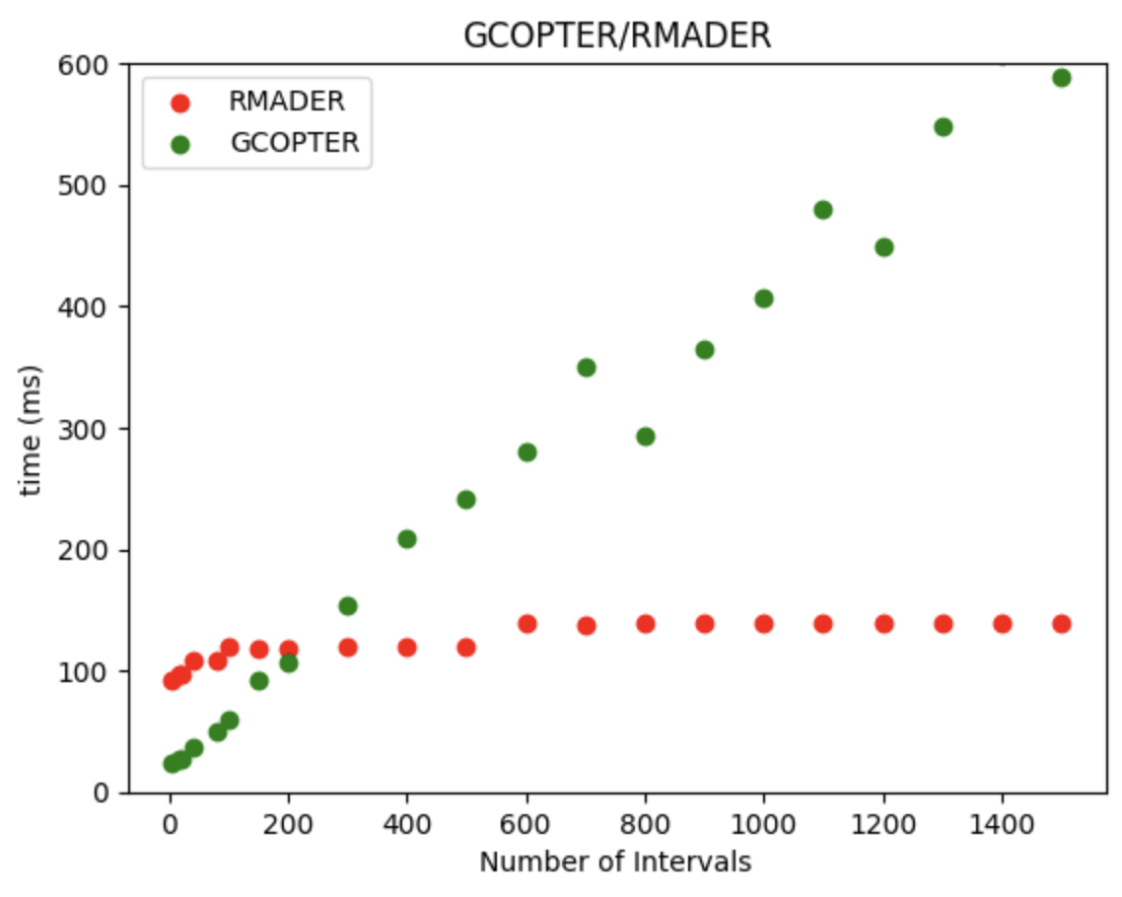
Comparison of Performance
Observations
GCOPTER shows a much larger rate of increase of time as numIntervals increases, compared to RMADER.
GCOPTER has better performance up till n = 200.
Notes:
Looking at these 2 graphs together, GCOPTER algorithm shows a much larger rate of increase of time as the number of intervals increases, compared to RMADER.
However, GCOPTER still has better performance up till n=200.

Slide 20
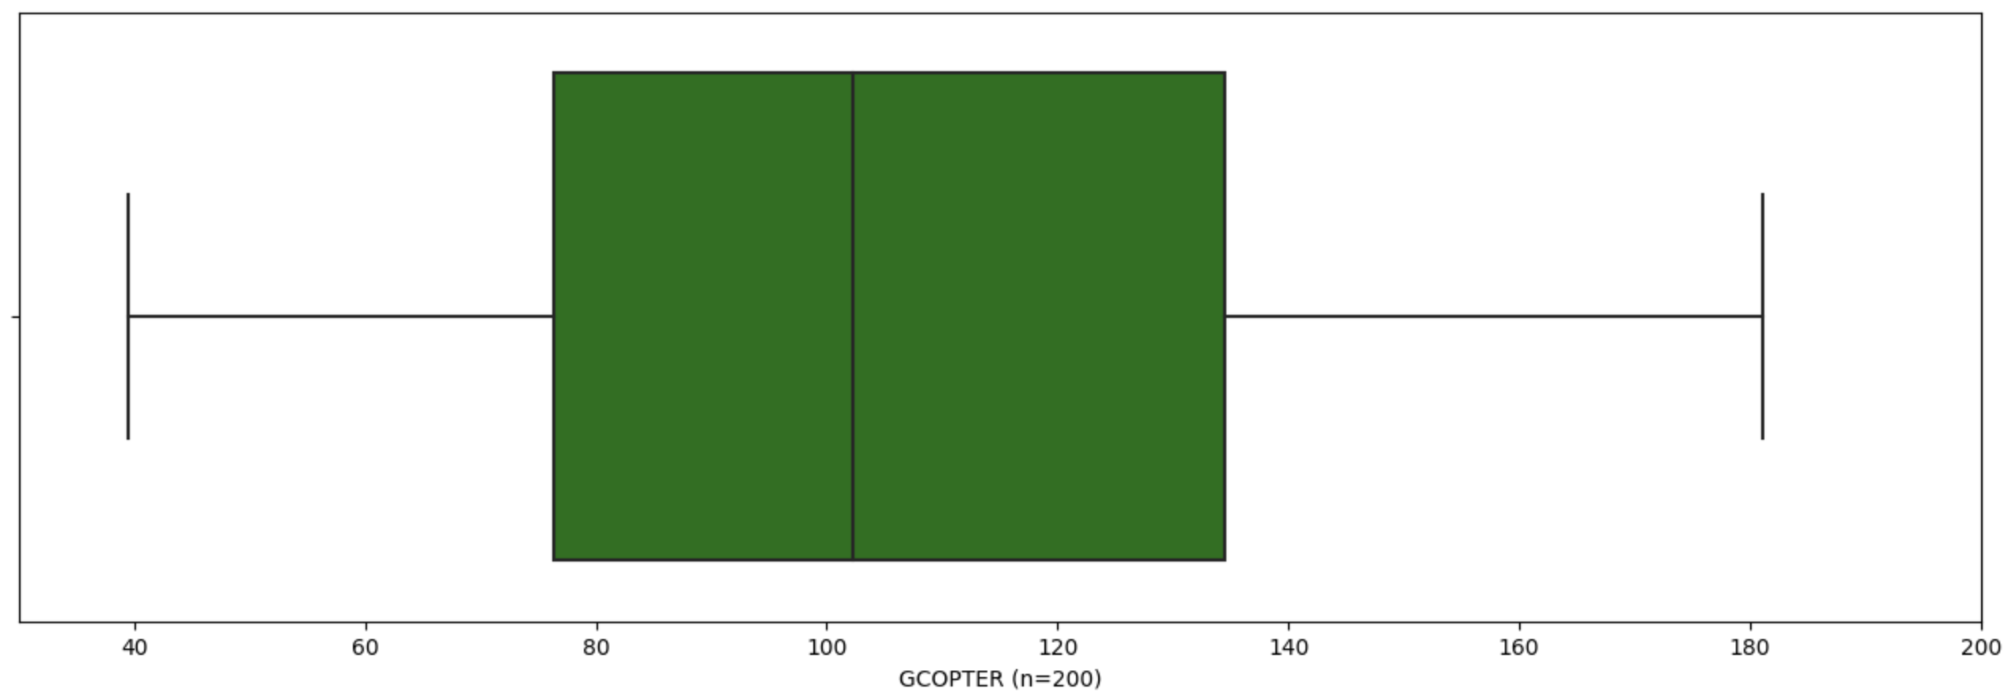
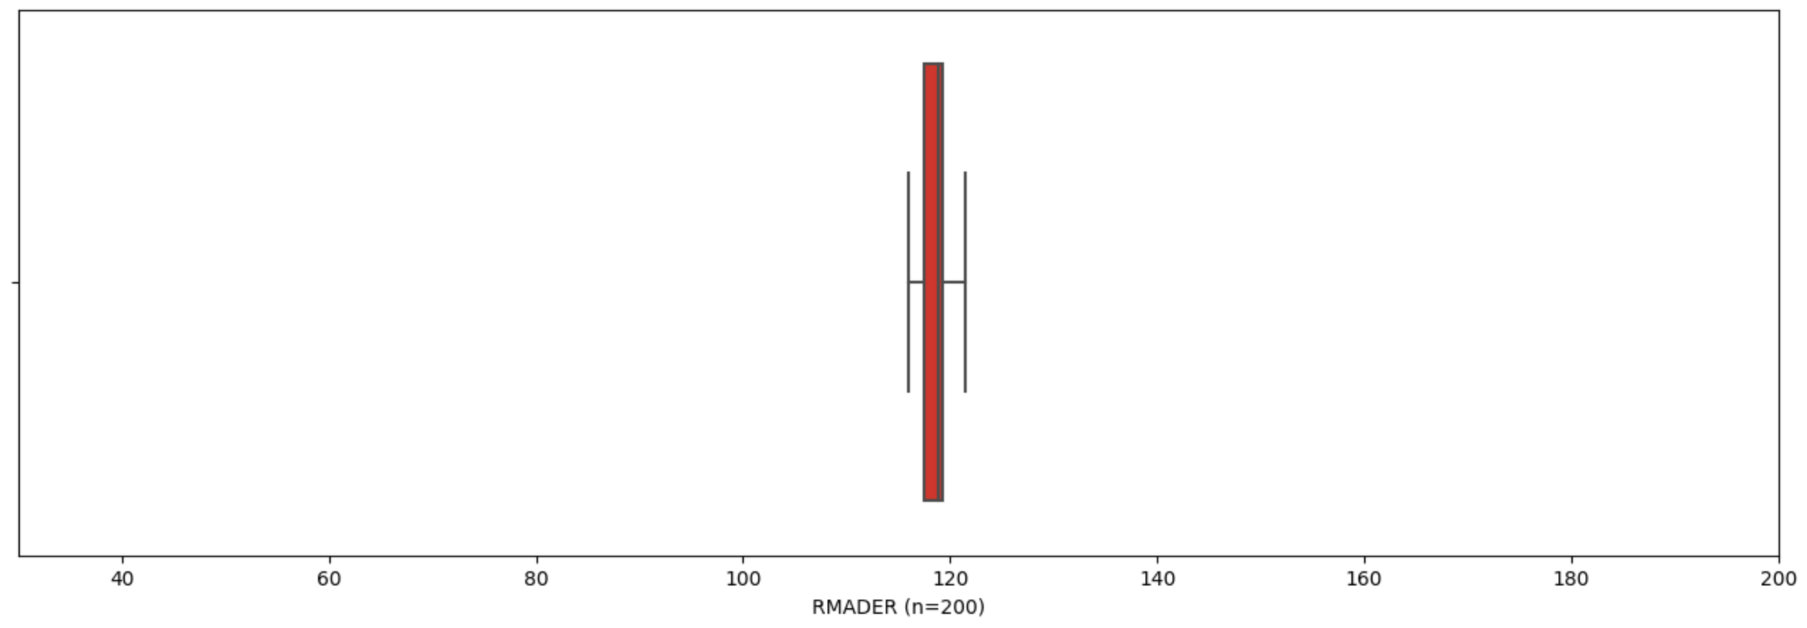
RMADER vs GCOPTER Performance (Spread)

Slide 21
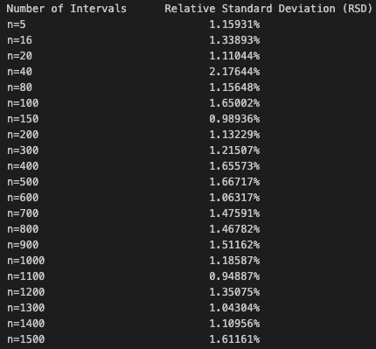
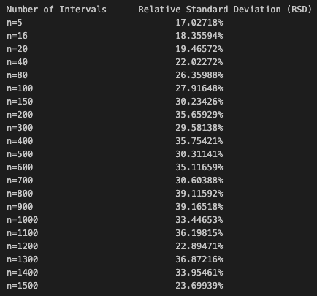
RMADER vs GCOPTER Performance (RSD)
RMADER
GCOPTER
Notes:
Relative Standard Deviation

Slide 22
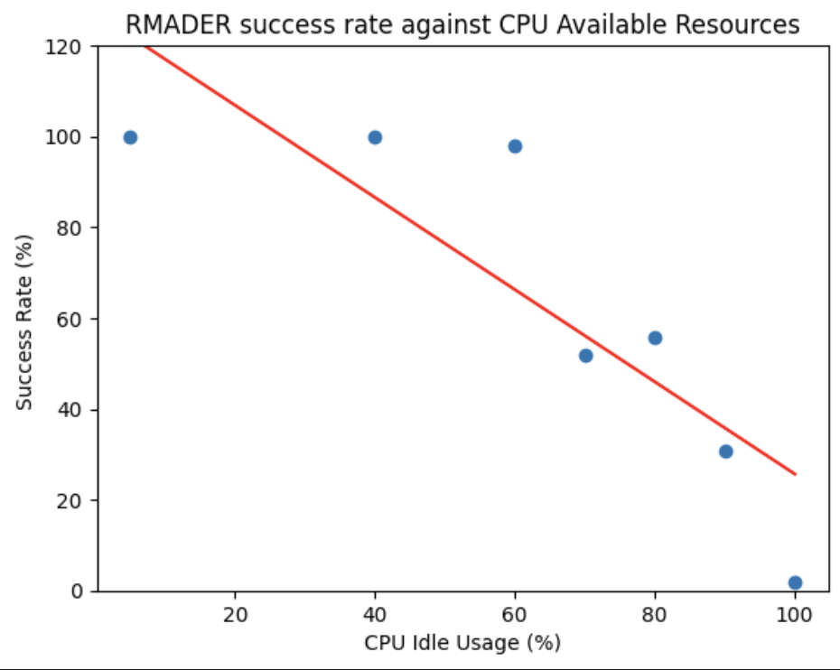
Performance of RMADER (CPU)
Use an infinite while loop in a bash terminal to consume CPU resources
Gradient = -1.015
Notes:
Next, let us look at how the performance of RMADER is affected by the percentage of CPU resources available.
In this graph, I only managed to measure the performance of RMADER against 7 different CPU Idle percentages (5, 40, 60, 70, 80, 90 and 100). The CPU resources were artificially consumed by running an infinite while loop in a bash file.
Over here, we can see that the success rate of RMADER decreased as the CPU resources were taken up by other tasks.

Slide 23
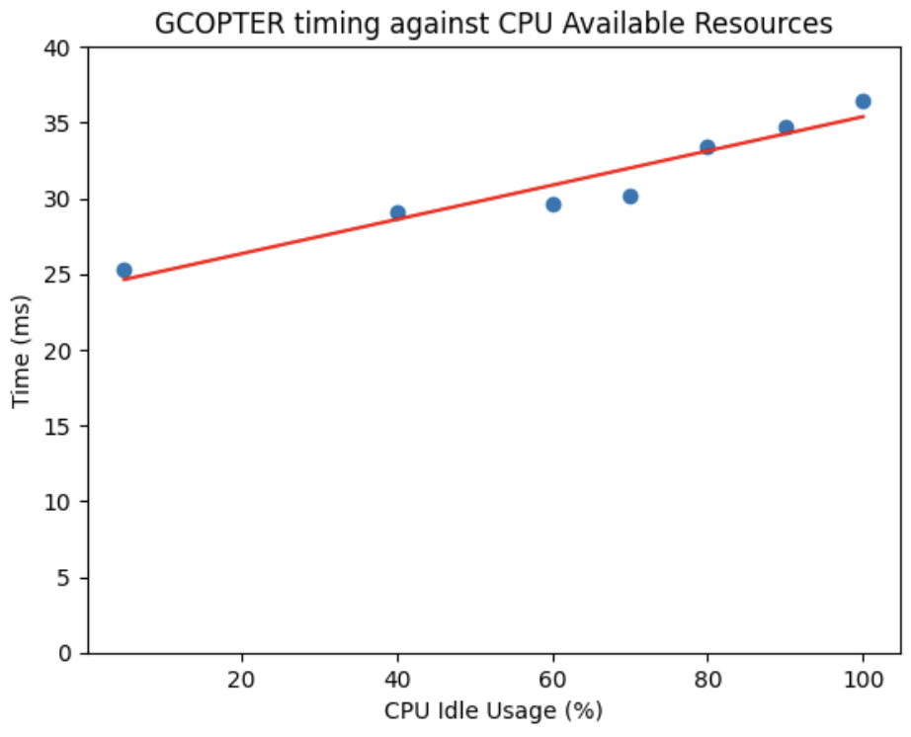
Performance of GCOPTER (CPU)
Unsuitable direct comparison due to GCOPTER performance being measured in time, while RMADER performance being measured in success rate.
Idea: Find a suitable (not necessarily entirely accurate) of Time to success rate.
Utilize relationship: time inversely proportional to success rate
Scale up the graph to the same scale as RMADER
Notes:
In the evaluation of the performance of GCOPTER against the percentage of CPU Available Resources, it is also seen that the GCOPTER algorithm takes longer to generate a complete path as CPU consumption increases.
At this point, we are unable to make a direct comparison due to GCOPTER’s performance being measured in time, while RMADER’s performance being measured in terms of success rate. As such, I transformed the GCOPTER graph by using relationships that time taken was inversely proportional to the success rate. From here, while the comparison between the 2 algorithms may not be the most mathematically accurate, it perhaps gives us some insight into how much the algorithm is affected by the amount of CPU resources available.
Transformations:
Utilize relationship → time is inversely proportional to success rate
Scale up to fit graph to appropriate scale for comparison with RMADER

Slide 24
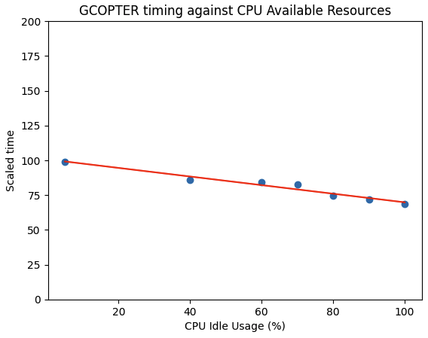
Comparison of Performance (CPU)
Gradient = -0.00012365
Gradient = -1.015
Notes:
This slide shows a comparison between both algorithms against different levels of free computational resources. We can see that GCOPTER’s performance is affected by a much lesser extent compared to that of RMADER.

Slide 25
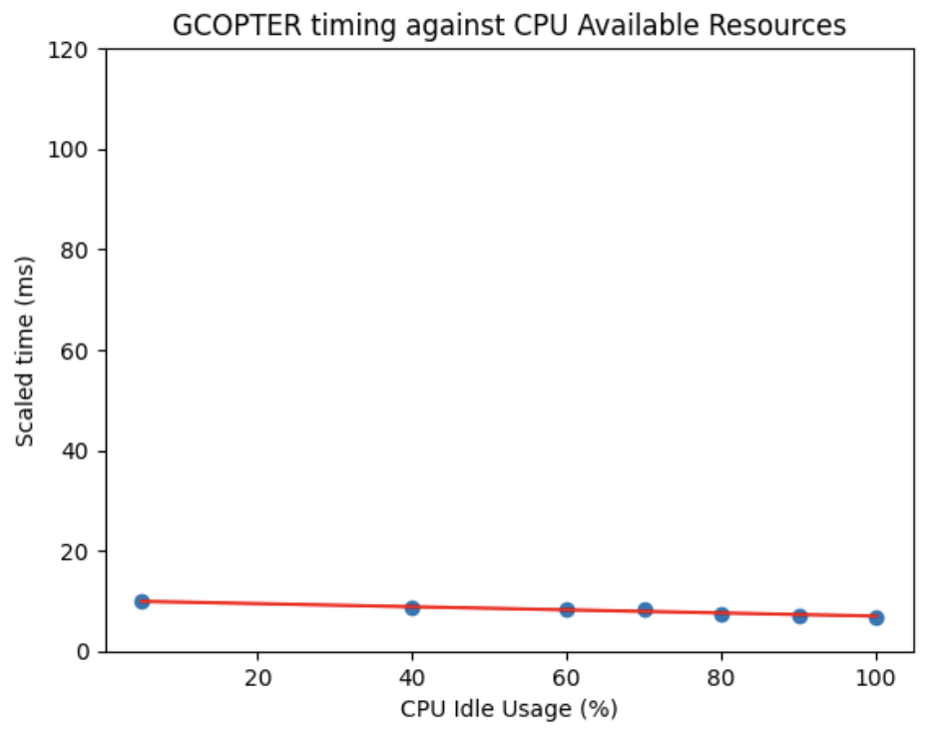
Comparison of Performance (CPU)
RMADER is more prone to failure when computational resources
are low as compared to GCOPTER.
Gradient = -0.00012365
Gradient = -1.015
Notes:
As such, we might conclude that RMADER is more prone to failure when computational resources are low as compared to GCOPTER.

Slide 26
Evaluation
Both RMADER and GCOPTER’s performance decayed as the number of discretization intervals increased.
GCOPTER’s performance decayed at a greater rate compared to RMADER.
GCOPTER performs better with low number of discretization intervals (n<200) as compared to RMADER.
Discretization Intervals
Notes:
In conclusion, both RMADER and GCOPTER’s performance decayed as the number of discretization intervals increased. Secondly, GCOPTER’s performance also decayed at a much greater rate compared to RMADER, while maintaining a better performance with a low number of discretization intervals.

Slide 27
Evaluation
Both RMADER and GCOPTER’s performance decayed as the number of discretization intervals increased.
GCOPTER’s performance decayed at a greater rate compared to RMADER.
GCOPTER performs better with low number of discretization intervals (n<200) as compared to RMADER.
Both RMADER and GCOPTER’s performance decayed as the percentage of CPU Available Resources decreases.
GCOPTER’s performance decayed at a much slower rate as compared to RMADER.
With limited CPU resources, GCOPTER seems to be more robust to failure.
Discretization Intervals
CPU Available Resources
Notes:
In terms of their performance against the CPU available, both algorithms show signs of slowing as CPU was consumed. However, this impact was much more significant in RMADER compared to GCOPTER.

Slide 28
Future Work
Shortcomings of current work | Recommendations
RMADER had to be manually tuned to find the runtime which would allow for complete path generation. | Edit the internal code within the nlopt-solver to exit the code only when the destination is found (ie no timeout).
CPU Resources could not be precisely tuned. Only managed to approximately increase/decrease CPU usage by running an infinite bash script. | Emulate the algorithms on a machine where CPU resources can be precisely tuned.
Notes:
For future work, I came up with 2 shortcomings with the current approach and recommendations to allievate them should these 2 algorithms be studied in future.
The first was how RMADER had to be manually tuned to find max runtime. The recommendation here would be to edit the internal code within the nlopt solver to exit the code only when the destination is found.
Next, in the CPU study, the CPU resources could not be precisely tuned. I only managed to approximately increase/decrease CPU usage by running an infinite loop within a bash script. The recommendation here would be to emulate the algorithms on a machine where CPU resources can be precisely tuned, or to run simulations on different machines with different computational power.

Slide 29
Future Work
Expand the test space to include different start / end points.
Expand the test space to include different maps.
Inclusion of dynamic obstacles.
Using a machine learning model to determine the best level of discretization for a given distance.
EGO-Planner-v2 (Swarm of micro flying robots in the wild)
RMADER was benchmarked against EGO-Swarm, with promising results. EGO-Planner-v2 is the upgraded swarm planner by ZJU-FAST-Lab.
To determine the ideal level of discretization for optimal performance of the algorithms
To do a comparison of RMADER with the swarm implementation of GCOPTER
Notes:
To expand further on this project, I have 2 suggestions.
The first would be to determine the ideal level of discretization for the optimal performance of algorithms. This could be done via expanding the test space to include different start and end points, expanding the test space to include more obstacles, and then using a machine learning model to determine the best level of discretization for a given distance.
Next, because RMADER was build to be run in a multiagent environment, a more detailed comparison could be done against the swarm implementation of GCOPTER, which was recently released under EGO-Planner-v2.

Slide 30
Challenges
Challenge | How they were overcome
Difficult to quantify the minimum time to generate a complete path in RMADER due to random environment factors and timeout issue. | Run the RMADER algorithm over 50 simulations and determine the success rate.
Trying to understand the complex mathematics and code behind the GCOPTER and RMADER algorithms. | Referring to modules online on optimization and control to gain insight into the different optimization strategies and path planning methods.
Notes:
Through the course of this project, I faced 2 main challenges. The first was that it was difficult the quantify the minimum time to generate a complete path in RMADER due to random environment factors such as CPU load. As such, for the tests, I ran the algorithm over 50 simulations to determine the success rate of generating a complete path over the 50 simulations to assess the performance of RMADER.
The next greatest challenge for me was trying to understand the complex mathematics and code behind the GCOPTER and RMADER algorithms. To alleviate this, I resorted to modules online on optimization and control to gain insight into the different optimization strategies and path planning methods.

Slide 31
Reflections
Interesting and fun project to work on
Researching on novel technology with sparse documentation and minimal support from the online community meant that understanding fundamentals became very important.
Learned how to break tasks up into more bite-sized and manageable pieces.
Notes:
Overall, this project has been a very interesting and fun one to work on.
The novelty of these algorithms meant that there was sparse documentation and minimal support from the online community, and this taught me that fundamental understanding on quadcopter dynamics as well as optimization and control was very important.
Lastly, with the thousands of lines of code to read through and the highly technical papers, I also learned to break my tasks down into more bite-sized and manageable pieces.

Slide 32
Feedback
Supervisors were extremely supportive through the course of this project, and offered guidance whenever I was lost or unsure about the task at hand.
Project was a little bit too technical and lengthy for a 2.5 month internship.
Notes and technical readings could be provided to help interns better understand the fundamental knowledge required for the project. It would help to scope and narrow the project down, and make the tasks more manageable.
Notes:
Supervisors were extremely supportive through the course of this project, and offered guidance whenever I was lost or unsure about the task at hand.
Project was a little bit too technical and lengthy for a 2.5 month internship. In order to allievate this, my suggestion would be to provide notes and technical readings to help interns better understand the fundamental knowledge required for the project. This would help to scope and narrow the project down, and make the tasks more manageable.

Slide 33
Thank you! Questions?
Notes:
With that, I have come to the end of the presentation. Thank you for your time, and I welcome any questions now!

Slide 34
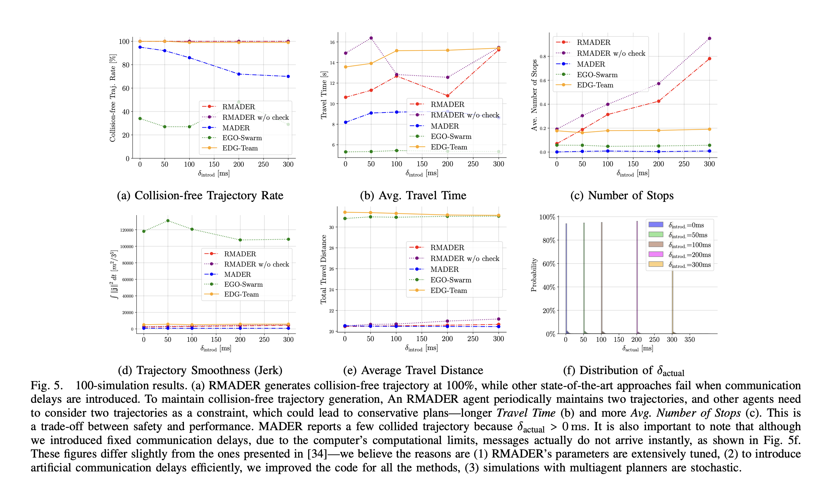
Appendix A
RMADER benchmark against other path planning algorithms

Slide 35
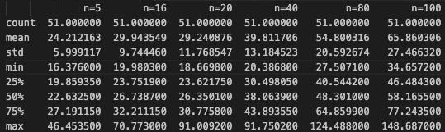
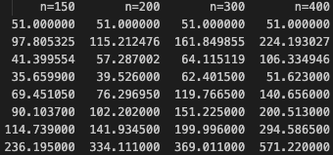
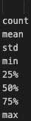
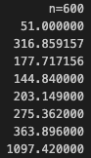
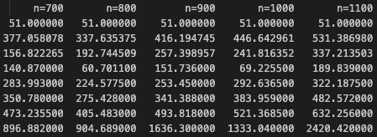
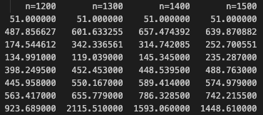
Appendix B1
GCOPTER Summary Statistics

Slide 36
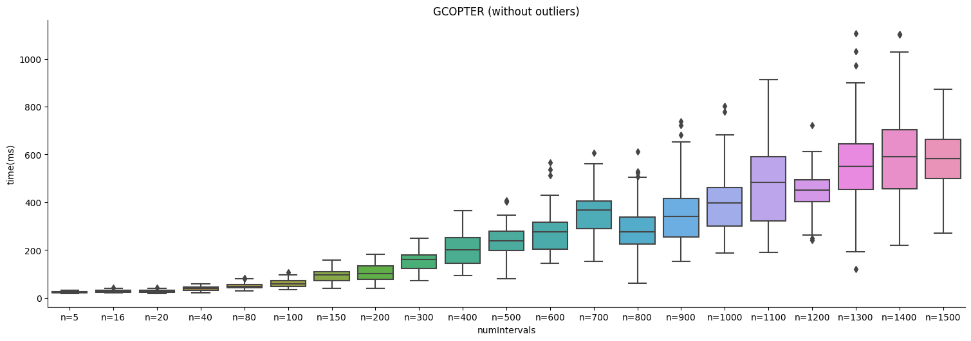
Appendix B2
GCOPTER Box Plot by numIntervals

Slide 37
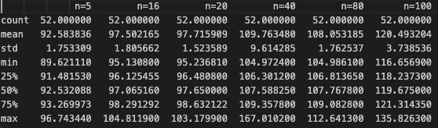
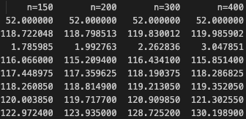
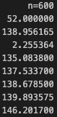
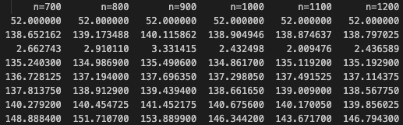
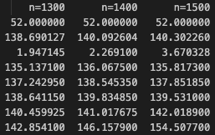
Appendix C1
RMADER Summary Statistics

Slide 38
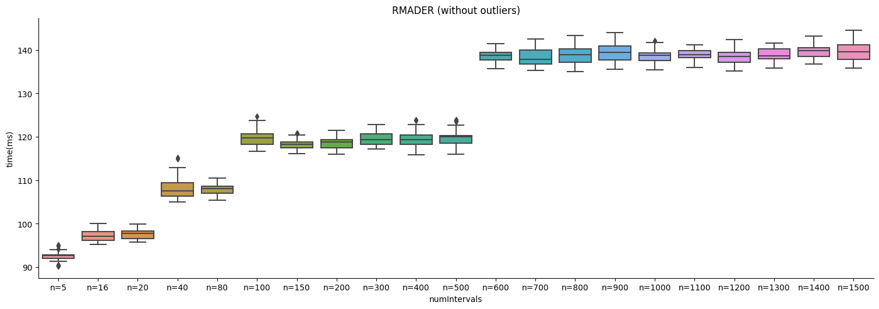
Appendix C2
RMADER Box Plot by numIntervals

Slide 39
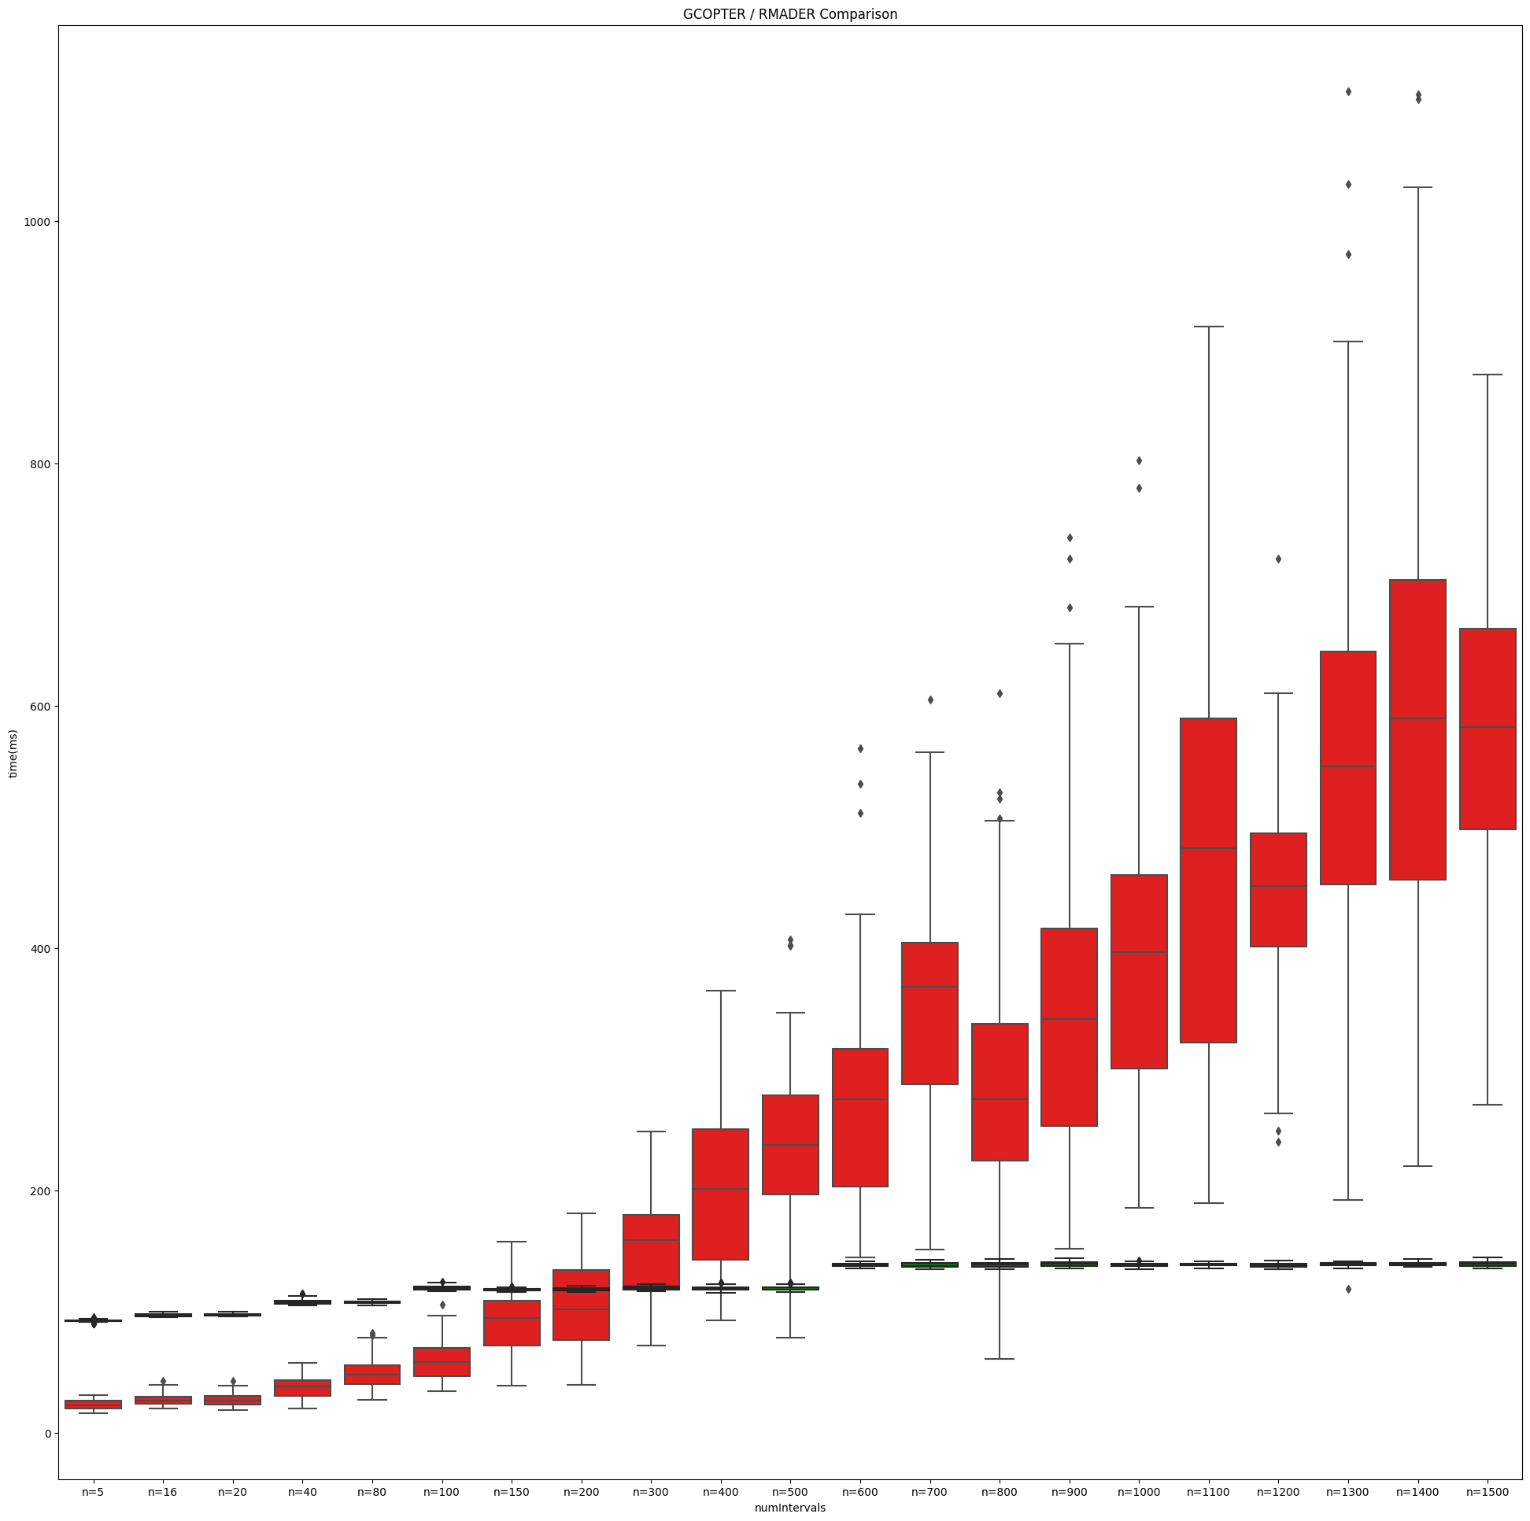
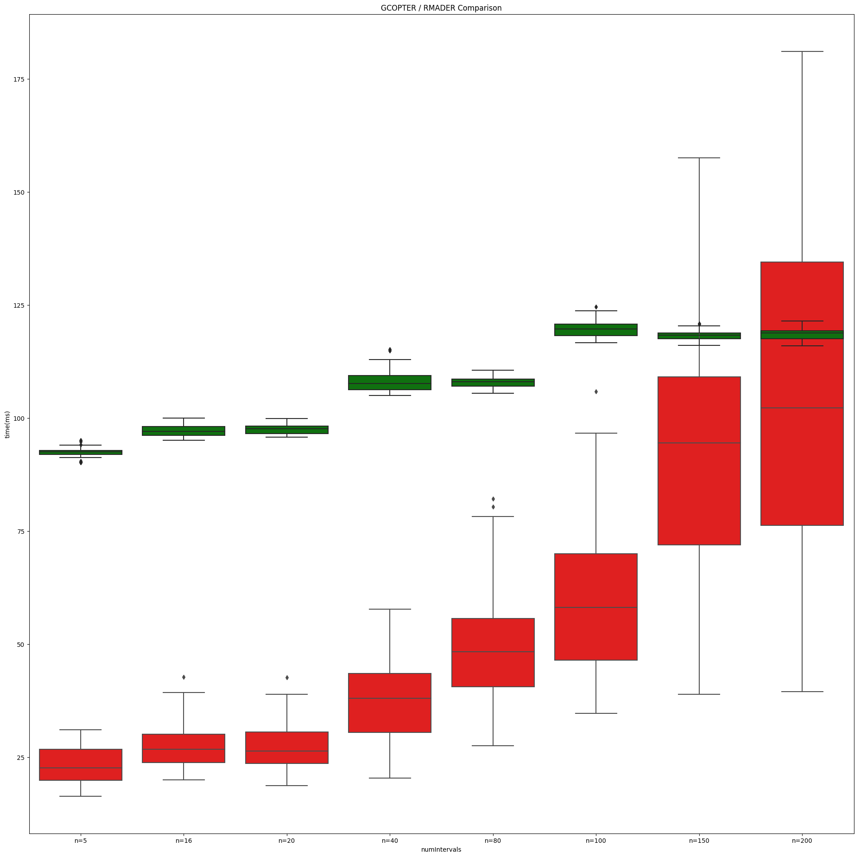
Appendix D
Box plot comparison of RMADER / GCOPTER

Slide 40
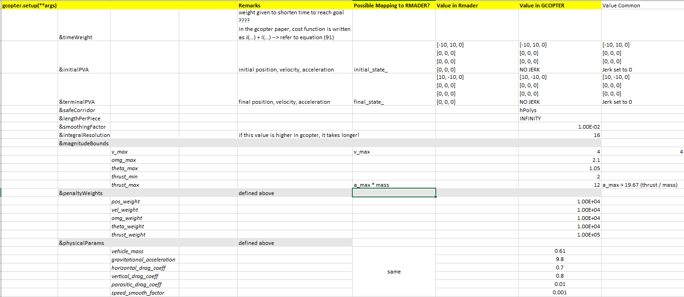
Appendix E
Configuration for planner setup

Slide 41
Appendix F
Simulation Environment vs RMADER Deployment Environment
Emulation Environment
11th Gen Intel(R) Core(TM) i7-1165G7 @ 2.80GHz 1.69 GHz
16.0 GB RAM
X64 based processor
RMADER Hardware
Intel® Core™ i5-10210U Processor (6M Cache, up to 4.20 GHz)
64GB RAM

Slide 42
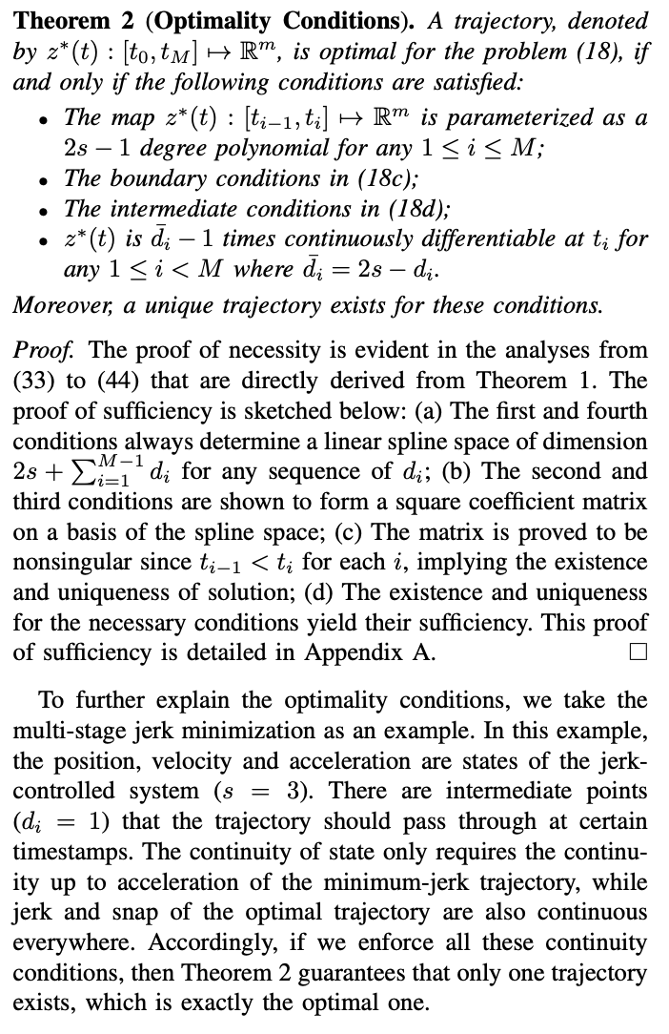
Appendix G
Proof of optimal path for minimization without cost functional

Slide 43
References
New algorithm keeps drones from colliding in midair. (2023, March 29). MIT News | Massachusetts Institute of Technology. https://news.mit.edu/2023/new-algorithm-keeps-drones-colliding-midair-0329
Ch. 10 - Trajectory Optimization. (n.d.-b). http://underactuated.mit.edu/trajopt.html
Kondo, K. (2023, March 10). Robust MADER: decentralized multiagent trajectory planner robust to communication delay in dynamic environments. arXiv.org. https://arxiv.org/abs/2303.06222
Tordesillas, J. (2020, October 21). MADER: trajectory planner in multi-agent and dynamic environments. arXiv.org. https://arxiv.org/abs/2010.11061

